Slide 1

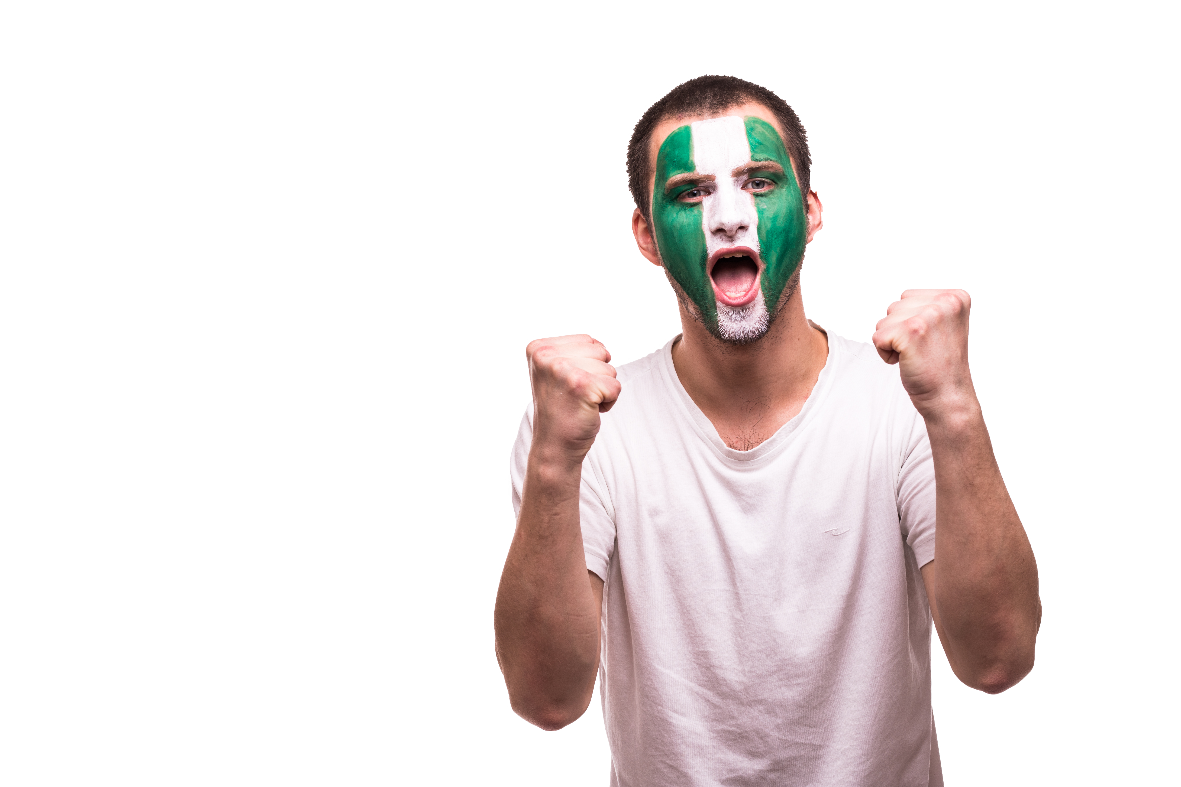
THE PHARMACEUTICAL ASSOCIATION OF NIGERIA STUDENTS
GLOBAL HEALTH SUMMIT
PANS NATIONAL SECRETARIAT, EDO STATE, NIGERIA.
FEBRUARY 28TH - 2nd MARCH
GLOBAL HEALTH SUMMIT

Slide 2
PROGRAMME PROPOSED EXPENDITURE
ITEM | DESCRIPTIONS | COST (N)

Slide 3
PROGRAMME PROPOSED EXPENDITURE
ITEM | DESCRIPTIONS | COST (N)
GRAND TOTAL

Slide 4
ESTIMATED INCOME
Delegate fee 3,500 per student
TOTAL | 875,000

Slide 5
PANS national hosts two national events every year, where pharmacy students across the country come together for networking and learning. The two events include:
1. Pharmacoposium
2. The National Convention.
This year, we are rebranding the Pharmacoposium to be a Global Health Summit (GHS).
It is going to be a three (3) day event which will feature:
A) The Pharmacoposium
B) A Pharma Fest
C) Picnic/excursion.
In order to accomplish the essence of making it a “Global Health Summit” we are inviting students from pharmaceutical Associations in West African countries. These countries include- Ghana, Burkina Faso, Benin Republic, Togo, Cameroon (Central Africa).
We are particular about these countries because they can easily come into Nigeria by road.
We will be sponsoring the accommodation and transportation of 2 international delegates per country WITHIN NIGERIA.
OVERVIEW
GLOBAL HEALTH SUMMIT

Slide 6
PHARMACOPOSIUM
The theme for the pharmacoposium is:
The role of Pharmacists and pharmacy students in elevating the profession.
We will be featuring 5 speakers from different countries to fit the idea of a “Global Health Summit”.
On the night of the pharmacoposium, we will also be having a party for all delegates (PANSites and international students).
PHARMA FEST
This is a festival for all delegates. The program will feature:
Arts exhibition, performance by guest artists, kissing booth, photo booth, shopping stalls, open mic & talent hunt, dance performance, body art, speed painting, games (snooker, table soccer).
A live band and a guest artist will also be present at the Pharma Fest to make the event colourful.
PICNIC/ EXCURSION
This is the last day of the Global Health Summit where we will take all delegates for an excursion/picnic.
OVERVIEW
GLOBAL HEALTH SUMMIT

Slide 7
At the end of the 3 day event, we were also advised to take the international students on a tour in Lagos, Nigeria.
We will be visiting some pharmaceutical companies and some tourist centers that are aimed at promoting the Nigerian culture and heritage
These include:
Nigerian Pharmaceutical industries; Emzor, Fidson as an example
Lekki conservation centre
Elegushi beach
National theatre
Freedom park Lagos
Mobee Royal Family Slave Relics Museum Badagry
Nike Art Gallery
It is going to be a 3 day event for pharmacy students in Nigeria and a 6 day event for the international students.
OVERVIEW
GLOBAL HEALTH SUMMIT

Slide 8
ABOUT PANS
The Pharmaceutical Association of Nigeria Students (PANS) is an association that comprises of Nigeria pharmacy students and unites it's members together through various events and activities.
The association constitutes of every student in all school of pharmacy in the giant of Africa, Nigeria.
GLOBAL HEALTH SUMMIT

Slide 9
HISTORY OF PANS
PANS was established in the year 1972.
It is found in every approved school by the Pharmacists Council Of Nigeria (P.C.N)
However, there is a national body of PANS made up of members from various universities in Nigeria.
GLOBAL HEALTH SUMMIT

Slide 10
ABOUT THE
NATIONAL
SECRETARIAT
•Every year the PANS National Secretariat revolves around approved and accredited pharmacy schools in Nigeria.
•The current PANS National Secretariat is Igbinedion University okada, which is the Nigeria's premier private University.
•It was founded in 1999. It is also the first private school entrusted to host PANS National activity.
GLOBAL HEALTH SUMMIT

Slide 11
ABOUT THE GLOBAL HEALTH SUMMIT
PHARMACOPOSIUM
PHARMA FEST
The Global health summit will consist of 4 major events
LAGOS TOUR FOR INTERNATIONAL STUDENTS
PICNIC / EXCURSION
GLOBAL HEALTH SUMMIT

Slide 12
DATES
GLOBAL HEALTH SUMMIT
27TH FEBRUARY 2022 - ARRIVAL
28TH FEBRUARY 2022 - PHARMACOPOSIUM
1ST MARCH 2022 - PHARMA FEST
2ND MARCH 2022 - PICNIC / EXCURSION FOR ALL STUDENTS
3/3/22 - JOURNEY TO LAGOS FOR INTERNATIONAL STUDENTS
4/3/22 - TOUR FOR INTERNATIONAL STUDENTS
5/3/22 - TOUR FOR INTERNATIONAL STUDENTS
6/3/22 - DEPARTURE FOR INTERNATIONAL STUDENTS

Slide 13
EXPECTED ATTENDEES
OF THE
GLOBAL HEALTH SUMMIT
DELEGATES FROM ALL 33 UNIVERSITIES OFFERING PHARMACY IN NIGERIA
PHARMACISTS ACROSS THE 36 STATES OF NIGERIA
WEST AFRICAN PHARMACEUTICAL STUDENTS
DELEGATES FROM OUTSIDE AFRICA
1,500 PHYSICAL ATTENDANCE
2,000 VIRTUAL ATTENDANCE
10 MILLION SOCIAL MEDIA REACH
GLOBAL HEALTH SUMMIT

Slide 14
HISTORY OF PHARMACOPOSIUM
1
2
3
4
4
5
OAU
OOU
UDUS
UNIPORT
UNIUYO
3rd Pharmaceutical Symposium in UDUS, Sokoto - 2019
4th Pharmaceutical Symposium in UNIPORT, Rivers state -2020
5th pharmaceutical symposium in UNIUYO, Akwa Ibom - 2021
1st Pharmaceutical Symposium in OAU, Osun State - 2017
2nd Pharmaceutical Symposium in OOU, Ogun State - 2018
GLOBAL HEALTH SUMMIT

Slide 15
THEME
THE ROLE OF PHARMACISTS AND PHARMACY STUDENTS IN ELEVATING
THE PROFESSION
GLOBAL HEALTH SUMMIT

Slide 16
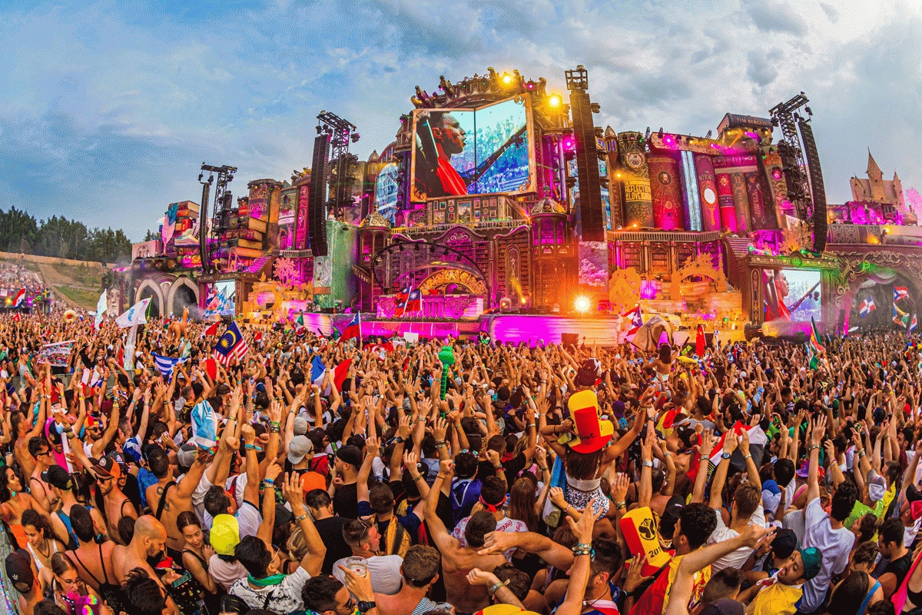
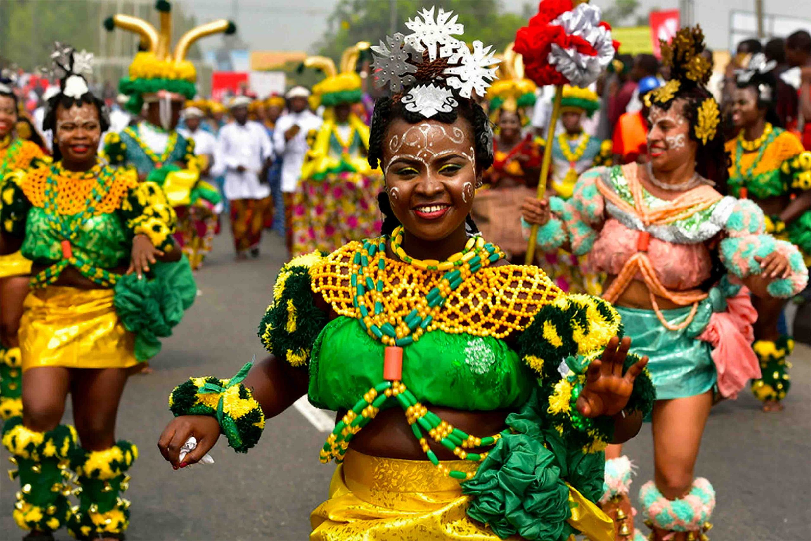
PHARMA FEST
The Pharma Fest is aimed majorly to give participants a fun-filled experience while getting to try new and interesting series of activities
ACTIVITES
The event will include the following:
•Art Exhibition, performance by guest artistes.
•Kissing Booth, photo Booth, shopping stalls.
•open mic & talent hunt, Dance performance.
•Body art, speed painting, and games (snooker,table soccer)
GLOBAL HEALTH SUMMIT

Slide 17
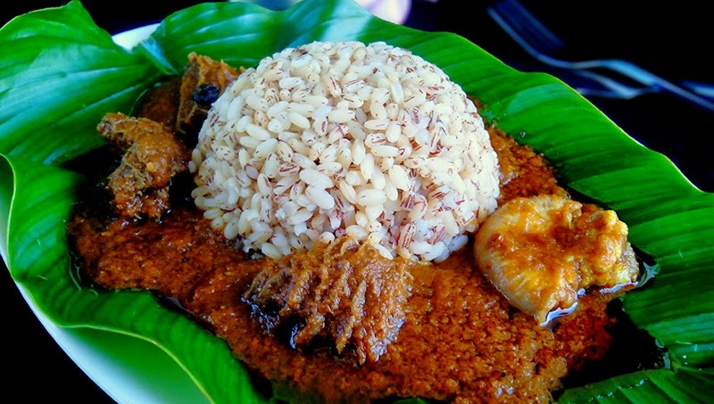
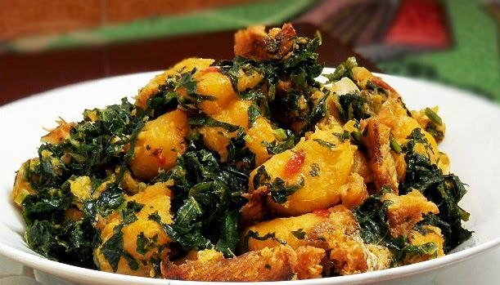
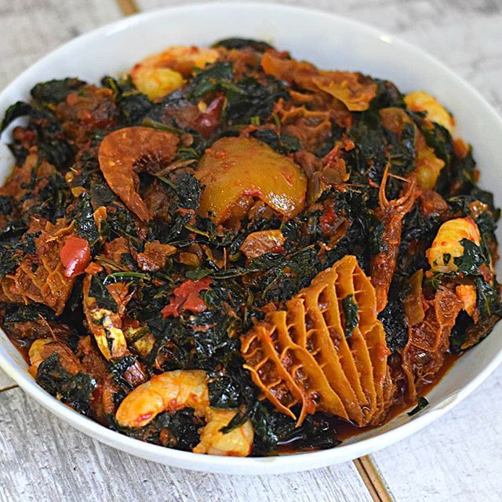
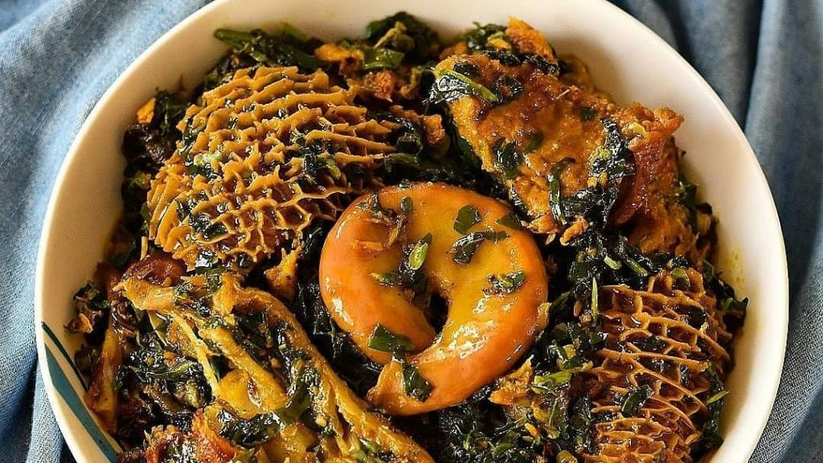
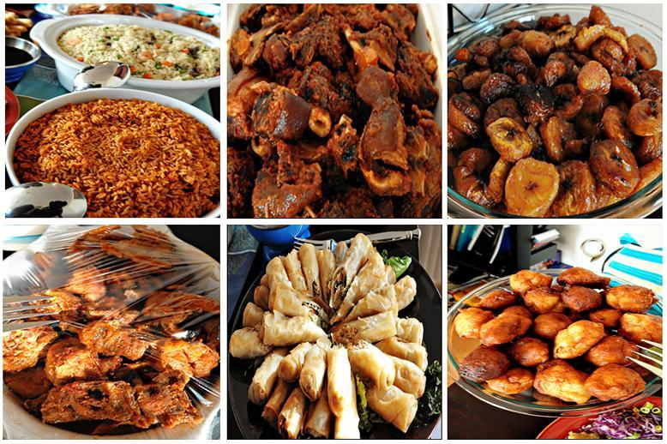
NIGERIAN DELICACIES
GLOBAL HEALTH SUMMIT

Slide 18
EXCURSION SITES
The site of interest is Lagos. The delegates will travel to various destinations in Lagos, get to see the beauty and history of country.
The various destinations include:
Nigerian Pharmaceutical industries Emzor, Fidson, etc
Lekki conservation centre
Elegushi beach
National theatre
Freedom park Lagos
Mobee Royal Family Slave Relics Museum Badagry
Nike Art Gallery
And lots more
GLOBAL HEALTH SUMMIT

Slide 19
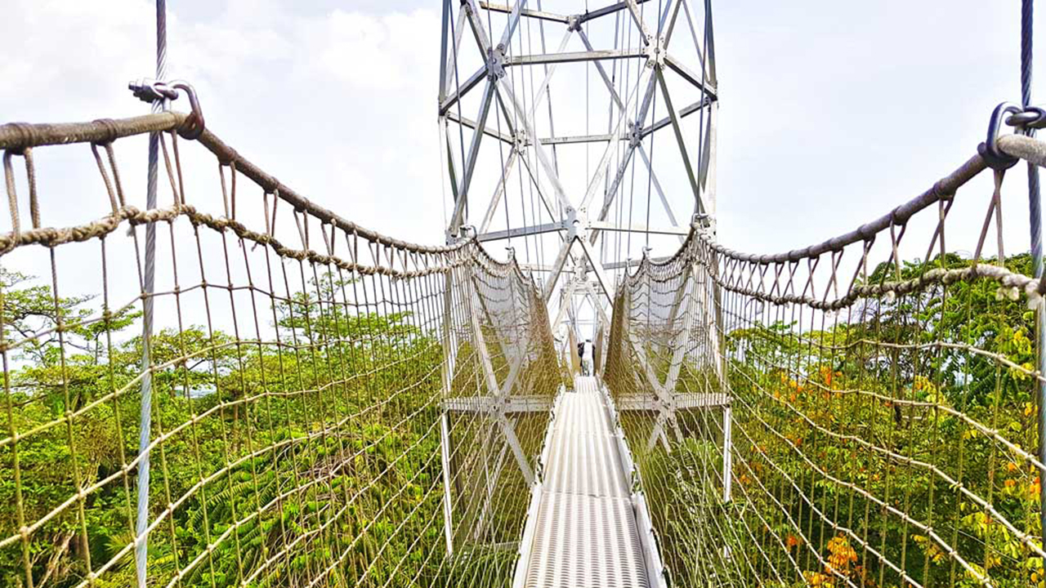
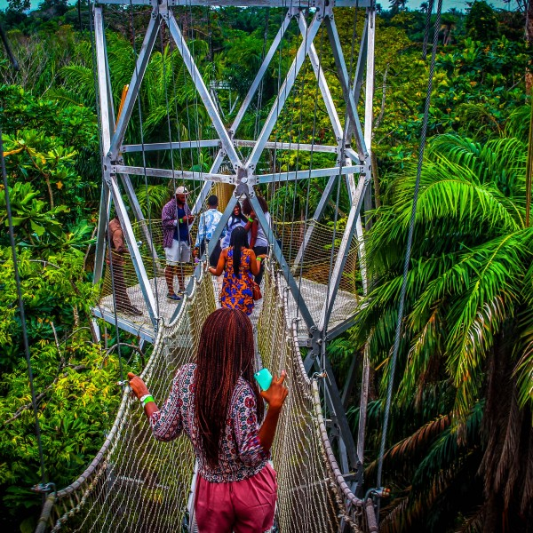
LEKKI CONSERVATION CENTRE
Lekki Conservation Centre in Nigeria has a 401-metre-long canopy walkway which is referred to as the longest canopy walkway in Africa.
Lekki Conservation Centre has a tree house, nature station, bird hide, swamp look-out station, rotunda, 96-seater gazebos, 6- and 8-seater family huts, floor games (ludo, snake and ladder, draught, chess and street tennis), koi & tilapia ponds, beach volley-ball courts & Spectators’ pavilion, barbecue joints, serene and secure environment
GLOBAL HEALTH SUMMIT

Slide 20
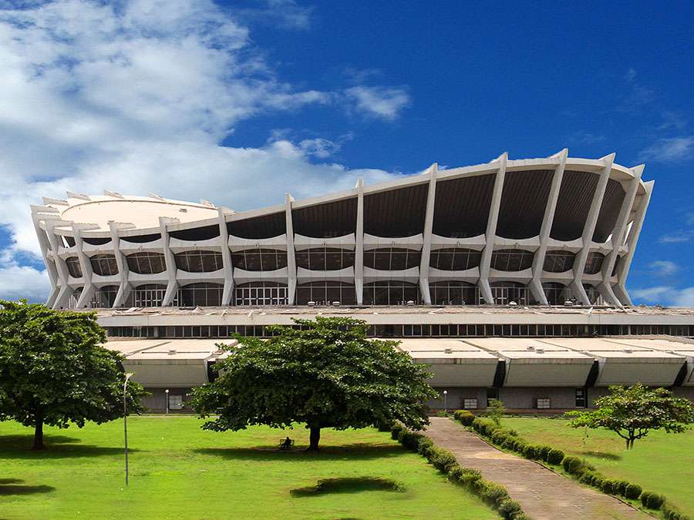
NATIONAL THEATRE
The National Theatre, Nigeria is the primary centre for the performing arts in Nigeria. The monument is located in Iganmu, Surulere, Lagos.
The National Theatre of Nigeria can be basically described as the NATIONAL HOME OF ENTERTAINMENT. Its management is committed to achieving the objectives for which the National Theatre was established, with regard to the presentation, preservation and promotion of arts and culture in Nigeria.
GLOBAL HEALTH SUMMIT

Slide 21
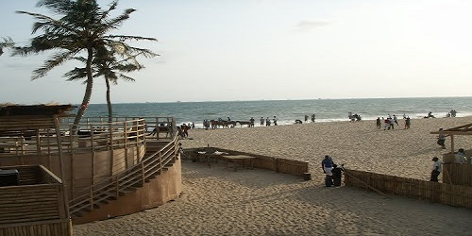
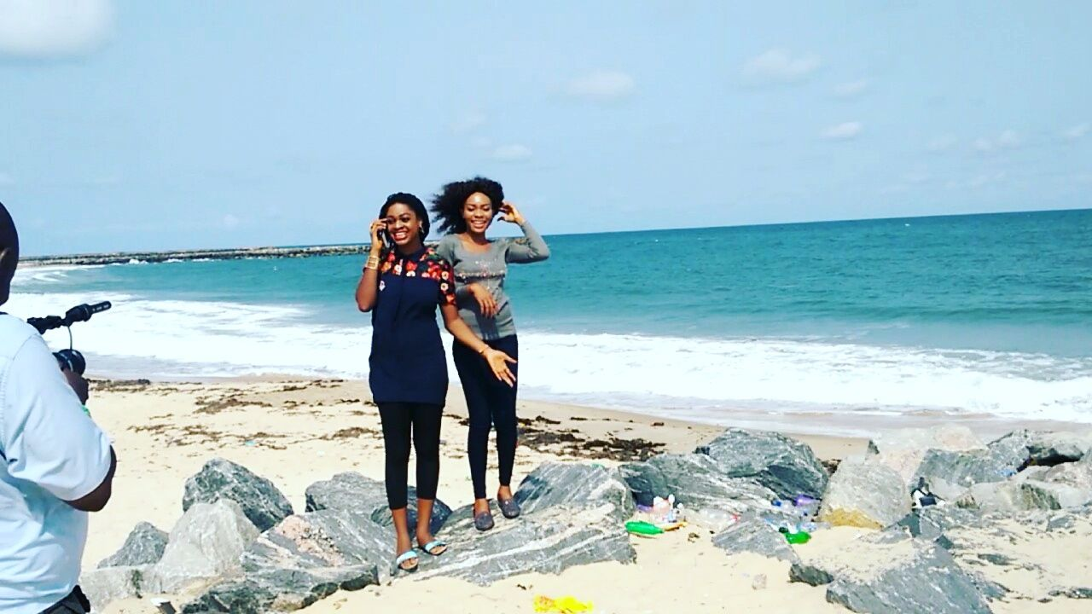
ELEGUSHI BEACH
Elegushi Beach is a private beach located at Lekki, Lagos state, southwest Nigeria.
The beach is owned by the Elegushi royal family in Lekki, Lagos state.
Elegushi private beach is seen as one of the best beaches in Lagos and Nigeria at large. The beach entertains close to 40,000 guests every week with Sundays being the best day on the beach. Over half of all guests that are entertained on the beach weekly visit on Sundays.
GLOBAL HEALTH SUMMIT

Slide 22
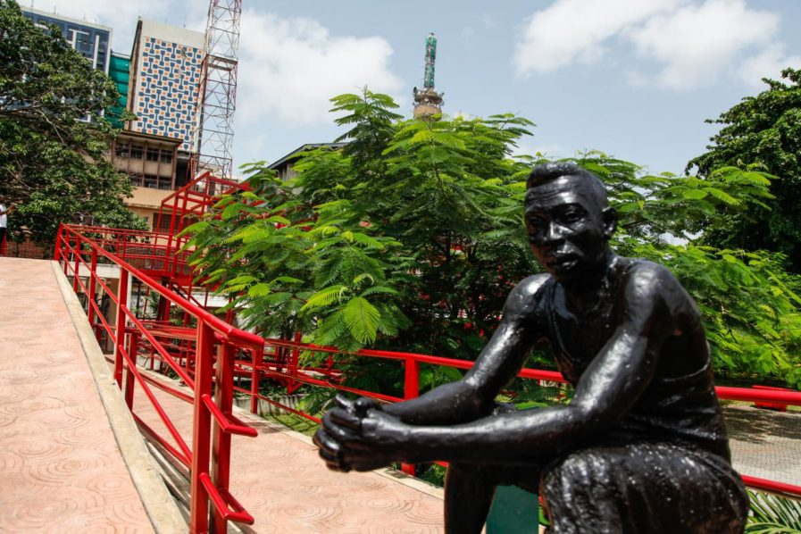
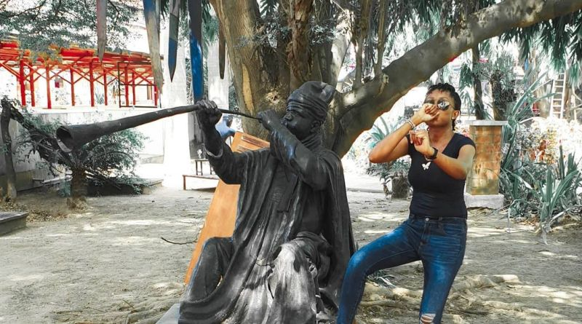
FREEDOM PARK
Freedom Park is a memorial and leisure park area in the middle of downtown Lagos in Lagos Island, Nigeria which was formerly Her Majesty's Broad Street Prison. It was designed by the Architect Theo Lawson.
The Park was constructed to preserve the history and cultural heritage of Nigerians. Monuments in the park reveal the Lagos colonial heritage and history of Her Majesty's Broad Street prisons. It was built to commemorate the 50th anniversary independence celebration in October, 2010. The Park serves as a National Memorial, a Historical landmark, a Cultural site, Arts and Recreation centre.
GLOBAL HEALTH SUMMIT

Slide 23
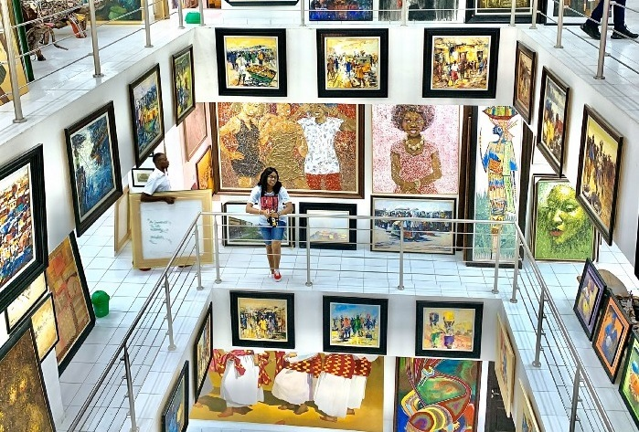
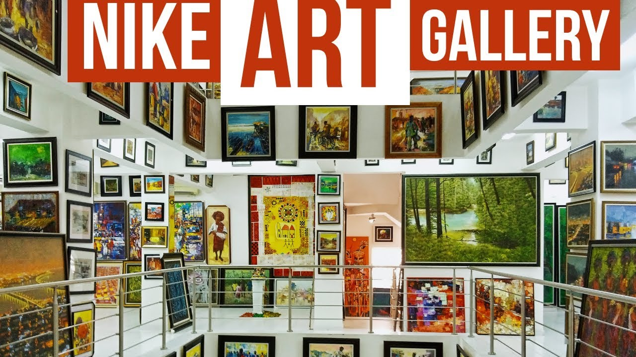
NIKE ART GALLERY
The gallery is arguably the largest of its kind in West Africa. Housed in a five-storey tall building, it boasts a collection of about 8,000 diverse artworks from various Nigerian artists like Chief Josephine Oboh Macleod.
GLOBAL HEALTH SUMMIT

Slide 24
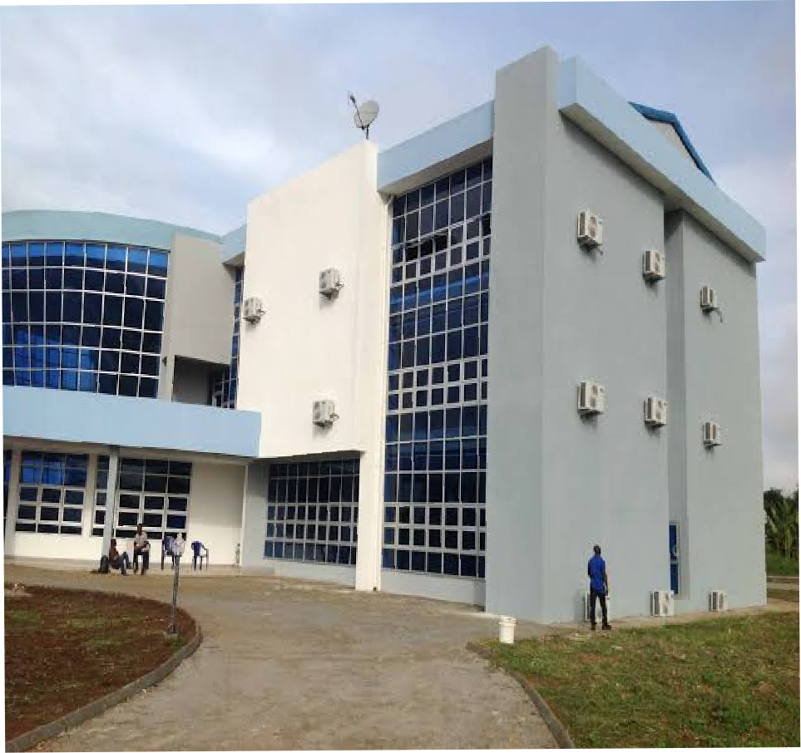
VENUE
The Global Health Summit is expected to be carried out at an auditorium of about 500 seater located in the national Secretariat
GLOBAL HEALTH SUMMIT

Slide 25
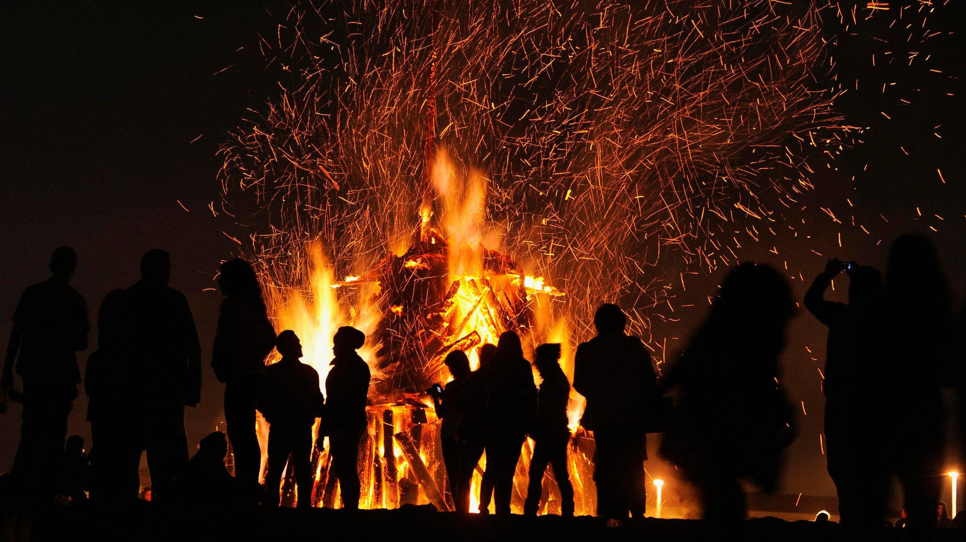
SOCIAL EVENTS
A range of mind blowing social events will be held during the symposium to provide a relaxing and fun filled experience, while giving participants opportunity to build friendships through interaction. Some of which are:
Welcoming events
Picnics
Bonfire night, etc.
GLOBAL HEALTH SUMMIT

Slide 26
FEES AND REGISTRATION
FEES AND REGISTRATION IS FREE FOR ONLY 2 DELEGATES PER COUNTRY
IF THERE ARE MORE THAN 2 DELEGATES PER COUNTRY, EACH EXTRA DELEGATE WILL PAY A REGISTRATION FEE OF $100
VERY NICE
GLOBAL HEALTH SUMMIT

Slide 27
REGISTRATION FOR INTERNATIONAL STUDENTS
GLOBAL HEALTH SUMMIT

Slide 28
QUESTIONS?
GLOBAL HEALTH SUMMIT

Slide 29
GLOBAL HEALTH SUMMIT
THANK YOU
GLOBAL HEALTH SUMMIT

